Slide 1
Impact on DECISION MAKING BY ADVERTISING
BATCH-29
053-G.Praveen
057-K.Ragava
058-J.Rohita
059-V.Suma
INDUSTRY – ADVERTISING
DEPARTMENT- DATA ANALYSIS

Slide 2
Presentation overview
Phase-1 – IDEATION
Phase-2 – FEATURE ENGINEERING
Phase-3 – DATA SET GENERATION
Phase-4 – MODEL SELECTION
Phase-5 – CODE AND OBSERVATION

Slide 3
PHASE –1
ADVERTISING CHALLENGES:
Reaching the right targeted audience.
Allocating enough budget.
Scalability.
High Competition.
Relying on one marketing channel.
Downplaying the power of emotions.
Source:
https://blog.hubspot.com/marketing/advertising-challenges

Slide 4
Problem statement:
Advertising- being with a good reach , there isn’t much impact on customers
OUTCOME:
Impact on customers decision………

Slide 5
PHASE –2
Feature collection:
Brand affinity
Perception
Social media
Celebrity reach
Competitive advertising
Customers regularity
Mode of communication
Clear message
Target group
Innovation
Truth
language
On-time delivery
Impersonal presentation
Speedy and mass communication
Persuasion
Expressiveness
Ethics
Demo about products and services
Seasonality

Slide 6
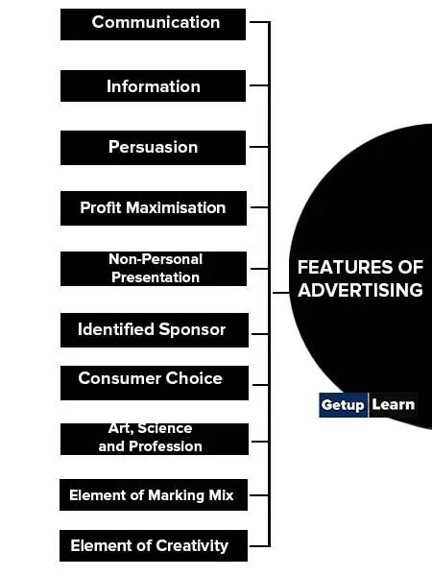
FEATURE SELECTION:
Customer Review
Quality
Innovation
Communication
Competition
Frequent remainders
Transperency
Sources:
https://www.yourarticlelibrary.com/essay/advertisement-definition-and-features-of-advertisement/27984
https://www.techtarget.com/searchcustomerexperience/feature/7-benefits-of-a-personalized-marketing-content-strategy

Slide 7
Phase-3
STEPS FOR DATA SET GENERATION:
STEP-1: Consider the features in selection and make them as attributes in the data set.
STEP-2: Consider primary data based on real time proofs and insert the data in other attributes accordingly.
STEP-3: After arranging the data calculate the weights .
SOURCES
https://www.searchenginejournal.com/online-review-statistics/329701
https://learn.g2.com/customer-reviews-statistics#impact-of-online-reviews-on-sales
https://sproutsocial.com/insights/social-media-statistics/#social-media-advertising-stats
https://www.forbes.com/sites/forbesmarketplace/2020/11/30/how-transparency-drives-value-in-digital-advertising-according-to-this-ceo/?sh=27e08f8763c4
P

Slide 8
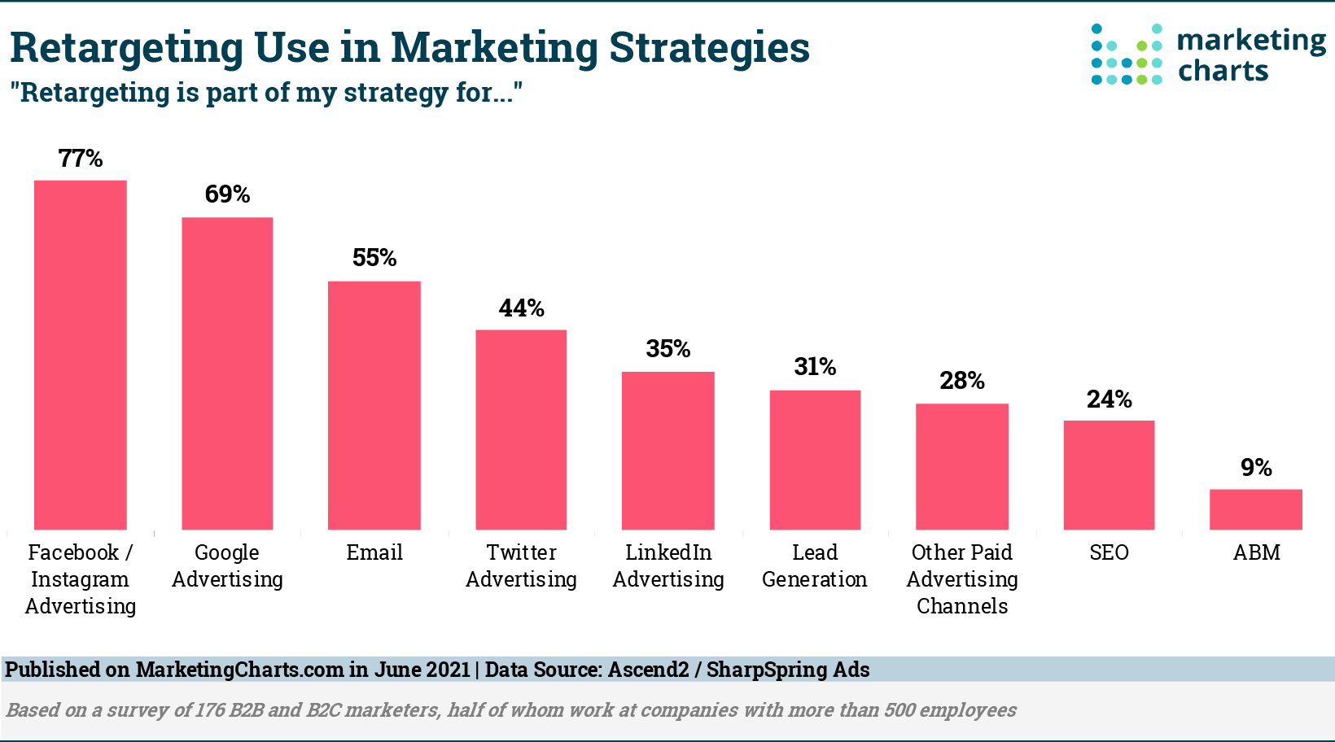
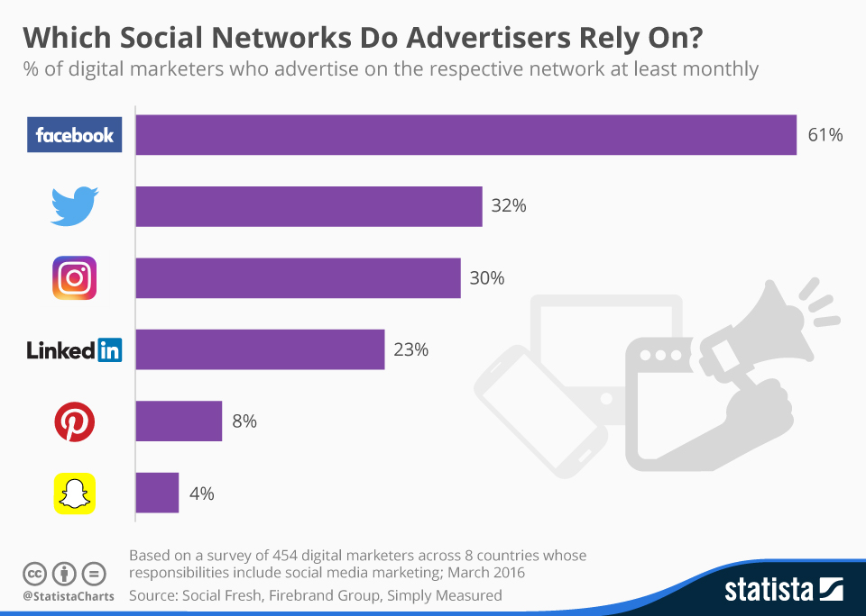

Slide 9
PHASE-4
Model selection : Random forest regression
Reasons for choosing model:
Can perform both regression and classification tasks
More accurate than the decision tree algorithm
Provides reasonable selection
Solves the issue of over-fitting
For numerical data accuracy we preferred random forest regression model over other models

Slide 10
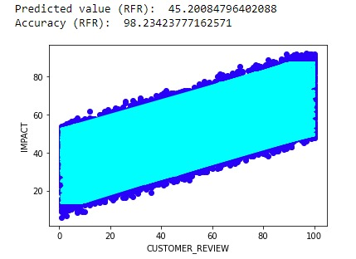
PHASE-5:
From the code we get the plots as

Slide 11
Conclusion
We came up here with a solution for the problem statement which can be used further as follows:
The features we selected can be resolved to get a good impact of advertising on customers.
Maybe our outcome can make a clearance of decision-making for the customers whether they would buy the product or not.
It can also be an advantage for advertisers to make their advertisements into the people's view

